Slide 1
V2 API Basics

Slide 2
2.1 Introduction to API Testing

Slide 3
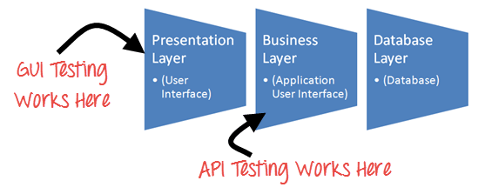
Introduction to API Testing
APIs, are the connecting tissue between different systems or layers of an application.
Applications often have three layers: a data layer, a service (API) layer, and a presentation (UI) layer.
The API layer contains the business logic of an application - the rules of how users can interact with services, data, or functions of the app.
API Testing concentrates on the business logic layer of the software architecture.
API testing commonly includes testing REST APIs or SOAP web services with JSON or XML message payloads being sent over HTTP, HTTPS, JMS, and MQ

Slide 4
API Test Environment Setup
It is mandatory to setup initial environment that invokes API with a required set of parameters and then finally examines the test result.
Database and server should be configured as per the application requirements.
Identifying the target audience and API consumer
Once the installation is done, the API Function should be called to check whether that API is working.
API Testing is different than other software testing types as GUI is not available
End points to be setup as per the requirement

Slide 5
2.2 Best Practices and Challenges in API

Slide 6
Best Practices and Challenges in API
Grouping test cases under test category
Parameters selection explicitly mentioned in each test case
Prioritizing API function calls
Each test case should be as self-contained and independent from dependencies as possible
Call sequencing should be performed and well planned
Automate wherever possible
To ensure complete test coverage, test cases should be created for all possible input combinations of the API.
Challenges of API Testing:
Main challenges in Web API testing is Parameter Combination, Parameter Selection, and Call Sequencing
Validating and Verifying different output in a different system
Parameters selection and categorization
Exception handling

Slide 7
Bugs that API testing detects
Fails to handle error conditions gracefully
Unused flags
Missing or duplicate functionality
Reliability Issues. Difficulty in connecting and getting a response from API.
Security Issues
Multi-threading issues
Performance Issues. API response time is very high.
Improper errors/warning to a caller
Incorrect handling of valid argument values
Response Data is not structured correctly (JSON or XML)

Slide 8
2.3 API Testing

Slide 9
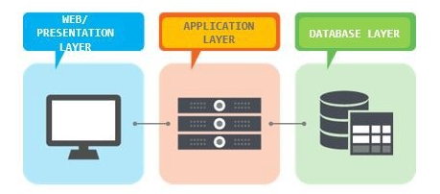
API
What is API?
API stands for Application Programming Interface.
API is an software to software interface, not a user interface.
With APIs, applications talk to each other without any user knowledge or intervention.
Implemented by writing function calls in the program.
It comprises of a set of functions that can be accessed and executed by another software system. Thus, it serves as an interface between different software systems and establishes their interaction and data exchange.
In the modern development world, many applications are designed based on three-tier architecture model.

Slide 10
API Testing
API testing uses software to send calls to the API and get the output.
The goal of API testing is to verify purpose/ correct performance and error handling of the component prior to its integration into an application.
API Testing is entirely different from GUI Testing and mainly concentrates on the business logic layer of the software architecture. This testing won't concentrate on the look and feel of an application. Instead of using standard user inputs(keyboard) and outputs, in API Testing, you use software to send calls to the API, get output, and note down the system's response.
Advantage:
Early Defect Detection:
If their are any issues with the REST services, It will be found before the developers actually consumer that web services. It will saves the development time over the defected web services.
Fast Result:
API Automation test jobs took very less time to complete the one testing cycle. this help in automating the regression suit for an application.
Reliable:
If these rest are passed without any issue then we can sure that business layer is not having any defect.

Slide 11
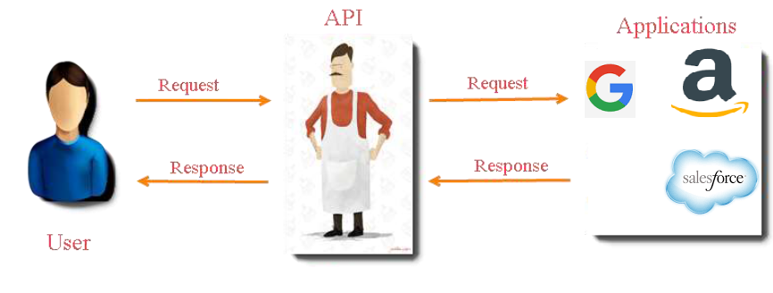
API Workflow

Slide 12
API Layer

Slide 13
API Tests
Verify if API doesn’t return any response.
Based on input request, return request should be checked.
Verification of the API whether it triggers some other event or calls another API
Verification of the API whether it is updating any data structure
Delayed in API Response time
Response Data is not structured
Difficulty in connecting and getting response from API

Slide 14
2.4 List of Popular API Testing Tools

Slide 15
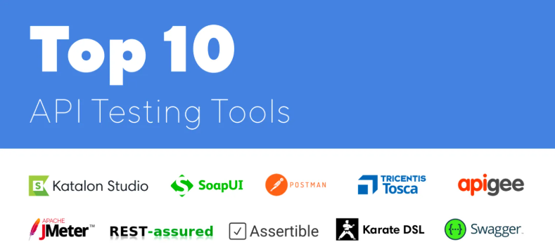
List of Popular API Testing Tools

Slide 16
2.5 API HTTP Methods & Status Code

Slide 17
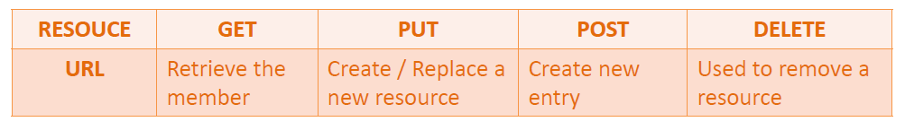
HTTP Methods
4 Commonly Used Methods:-
GET : - Provides a read only access to a resource.
POST :- Used to update an existing resource or create a new resource.
PUT :- Used to create a new resource.
DELETE :- Used to Remove a resource.

Slide 18
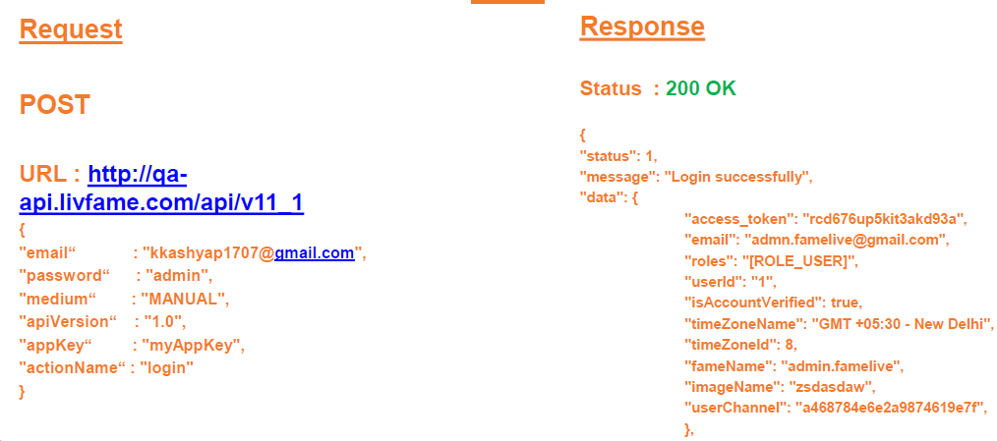
Sample HTTP Method

Slide 19
HTTP Request And Response
HTTP Request:
Header
Body
URI
Path
Resources
End Point
Query Parameter
HTTP Response:
Header
Body
Status Code

Slide 20
HTTP Status codes
200 OK: - Code indicates that the request was successful.
201 Created:- Code indicates that request was successful and a resource was created. It is used
to confirm success of a PUT or POST request.
400 Bad Request :- It happens especially with POST and PUT requests, when the data does not
pass validation, or is in the wrong format.
404 Not Found:- response indicates that the required resource could not be found.
401 Unauthorized:- error indicates that you need to perform authentication before accessing the
resource.
405 Method Not Allowed:- HTTP method used is not supported for this resource.
409 Conflict:- Conflict request to create the same resource twice.
500 Internal Server Error:- Occurs due to some error on Server side.

Slide 21
2.6 Exercise to Identify Open API's ( SOAP and REST )

Slide 22
Exercise to Identify Open API's ( SOAP and REST )
REST Base URL:
https://petstore.swagger.io/
SOAP Base URL:
http://webservices.oorsprong.org/websamples.countryinfo/CountryInfoService.wso?WSDL
http://www.dataaccess.com/webservicesserver/numberconversion.wso?WSDL

Slide 23
2.7 API Test Project Structure

Slide 24
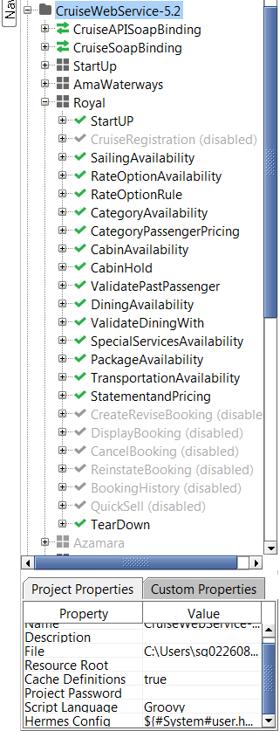
API Test Project Structure
Project
Test Cases
Scenario
Test Steps
Request/Data source/Groovy Script
Test Suite
Resource Binding
API/Functioanity

Slide 25
Parts of an API
REST APIs have four types of parameters:
Header parameters: Parameters included in the request header, usually related to authorization.
Path parameters: Parameters within the path of the endpoint, before the query string (?). These are usually set off within curly braces.
Query string parameters: Parameters in the query string of the endpoint, after the ?.
Request body parameters: Parameters included in the request body. Usually submitted as JSON.

Slide 26
Thank You

